Slide 1


PPS MINI PROJECT Inventory Management in stores
BY Parth Parab
RA2111030010061

Slide 2
Abstract
The project's goal is to create a program that deals with the use of structure arrays, pointers, and other functions. This program can perform array operations such as insertion, retrieval, exiting, and so on. We can use the program to smoothly and efficiently arrange items in a grocery store's inventory by using the listed functions.

Slide 3
Problem Statement and Description
Proper inventory and goods listing is critical to the smooth operation of a business.
Keeping track of inventory and sales in hand-made books and ledgers is both tedious and time consuming.
Written ledgers and books are also susceptible to loss or damage. In the long run, they also take up a lot of physical space.

Slide 4
Objective
The goal of this project is to use C programming to create a programme that can easily input and list a store's inventory.
We can create a program in C that records the name, code, quantity, price, and manufacturing date of any product we need to list by using structures and loops.

Slide 5
Proposed methodology
The proposed methodology involves the use of structures and loops. The initial structures are created for the manufacturing date and the listed details. The number of items and the specifics of each item are then entered. Finally, the list of items and their details are printed in the order in which they were entered.

Slide 6
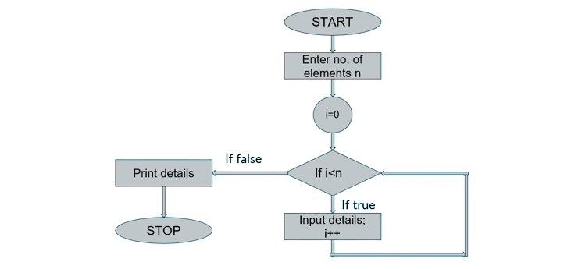
Flowchart

Slide 7
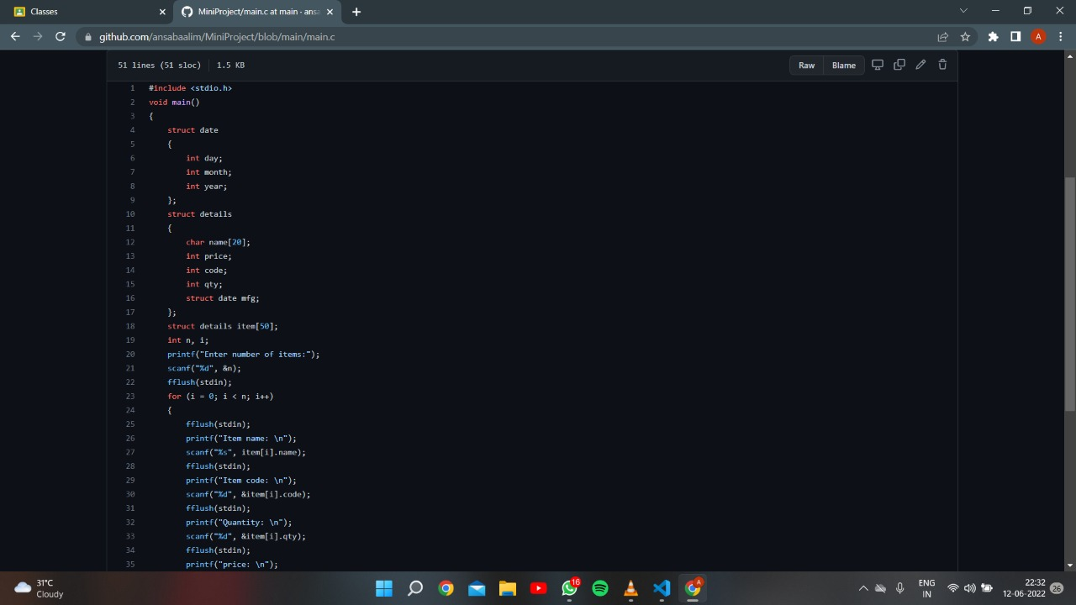
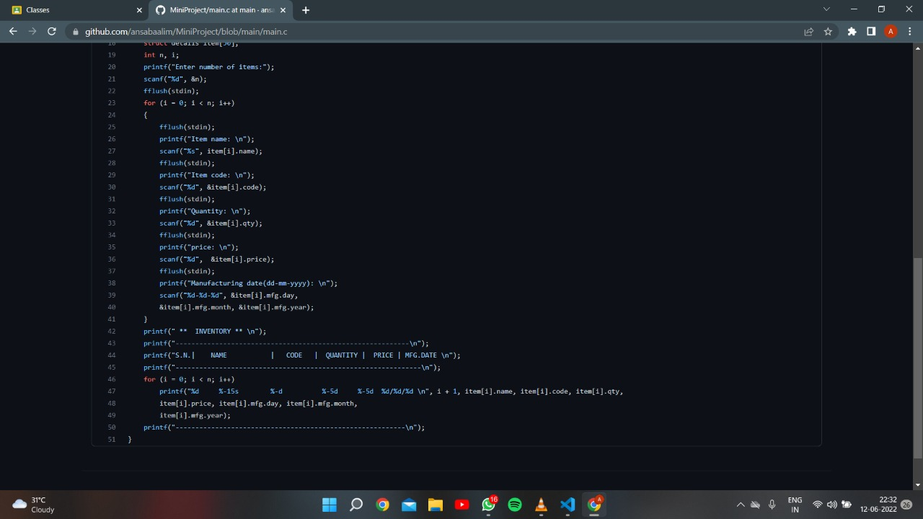
Coding

Slide 8
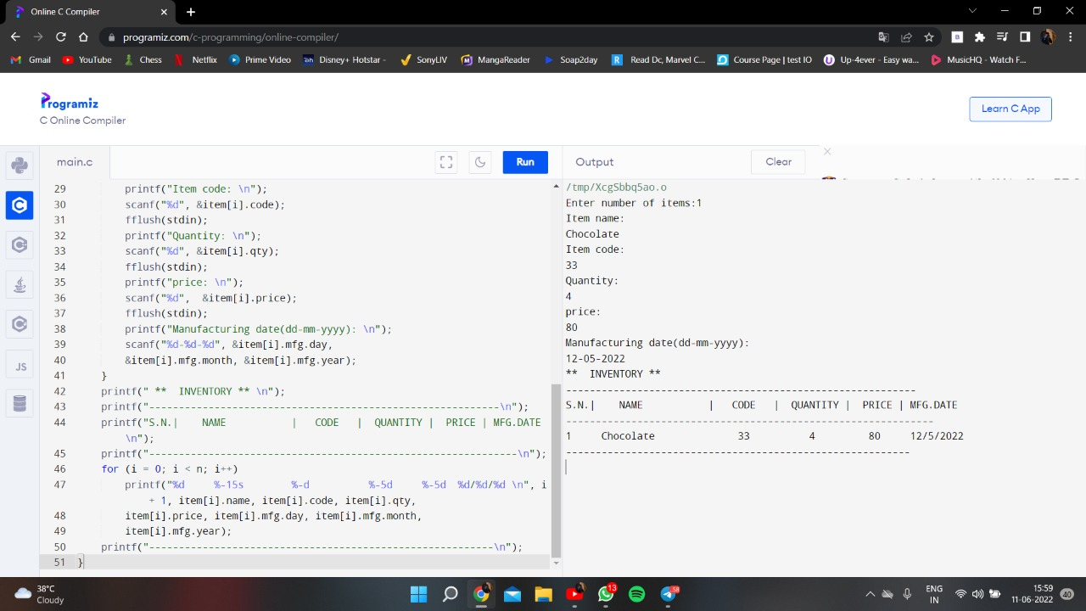
Coding Output

Slide 9
Result
A programme was developed that can accept multiple item inputs along with their name, quantity, price, and manufacturing date and then print them all in an orderly fashion.

Slide 10
Conclusion
We were able to learn how to properly and effectively implement structures and loops in practise by using them in practise.The programme created is capable of producing the desired result smoothly and correctly.

